Slide 1


Store of Coffee
- Data Analysis Project -
2019 - 2022
Omnia Mohamed. Data Analyst
https://www.linkedin.com/in/dataanalyst-omniamohamed/

Slide 2

STORE OF COFFE
2019 – 2022
What will we discuss?
Omnia Mohamed. Data Analyst

Slide 3
Intro
2. METHODOLOGY
Purpose
Some Objectives
Scope
Data Duration
Limitations
Process [ Cleaning ]
Omnia Mohamed. Data Analyst

Slide 4
3. METHODS
4. Summary
Data Analysis
Data Visualization
Report
KEY FINDINGS
4. DASHBOARD OVERVIEW
5. Conclusion
Charts
KPIs
RECOMMENDATIONS
Omnia Mohamed. Data Analyst

Slide 5

STORE OF COFFE
2019 – 2022
Introduction
Omnia Mohamed. Data Analyst

Slide 6

Purpose
To Know the total sales was decreasing or increasing during years from 2019 to 2022.
Omnia Mohamed. Data Analyst

Slide 7
Objectives /Questions
How many types of coffee that we have?
What is the top types of coffee in rev.?
What sizes that we have ?
What is the best-selling size ?
Unit price vs size in rev.
Does the revenue decrease or increase during the 4 years?
How many customers that we have?
How many / what Countries customers from?
Emails- how many customers are ready / have intent to know offers or any new about store ?
Omnia Mohamed. Data Analyst

Slide 8

Scope
Total Sales during the years.
Unit Prices
Omnia Mohamed. Data Analyst

Slide 9
STORE OF COFFE
2019 – 2022
2. METHODOLOGY
Omnia Mohamed. Data Analyst

Slide 10
Data Duration: 2019 - 2022
Limitations: - missing data in the section of the total sales in year 2022 – missing data in section of countries.
Omnia Mohamed. Data Analyst

Slide 11
3. Process [ Cleaning ]:
Creating Data from the provided file
Formatting
Remove Duplicates
Nulls
Omnia Mohamed. Data Analyst

Slide 12
Process :
Creating Data from the provided file
Omnia Mohamed. Data Analyst

Slide 13
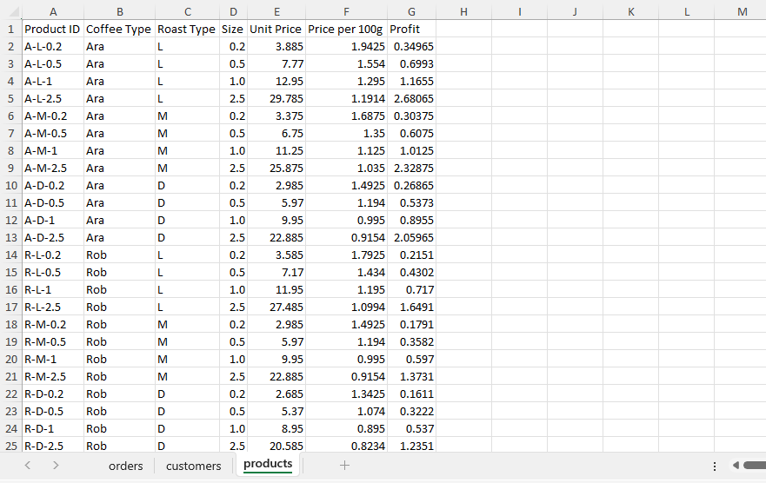
Omnia Mohamed. Data Analyst

Slide 14
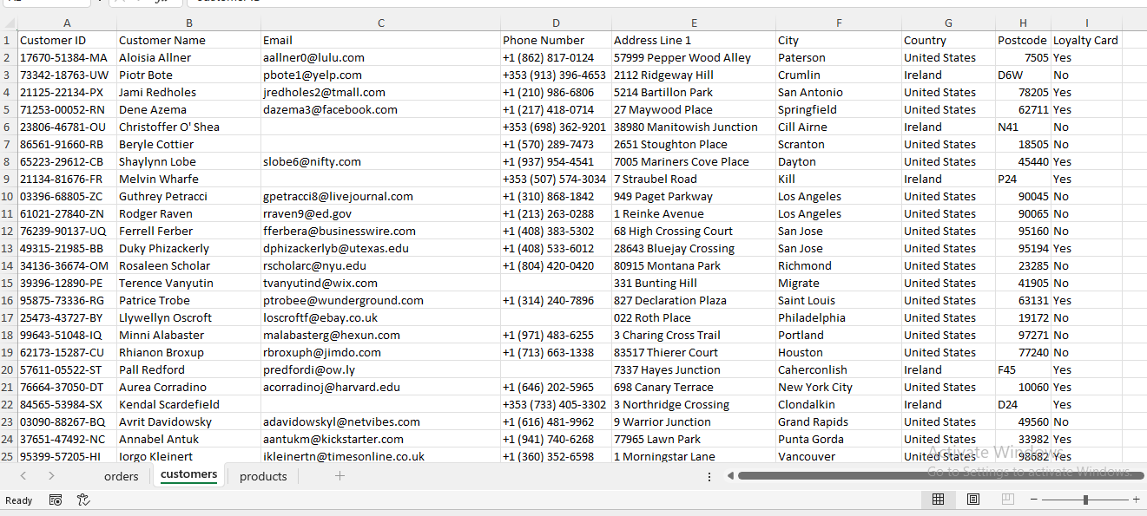
Omnia Mohamed. Data Analyst

Slide 15
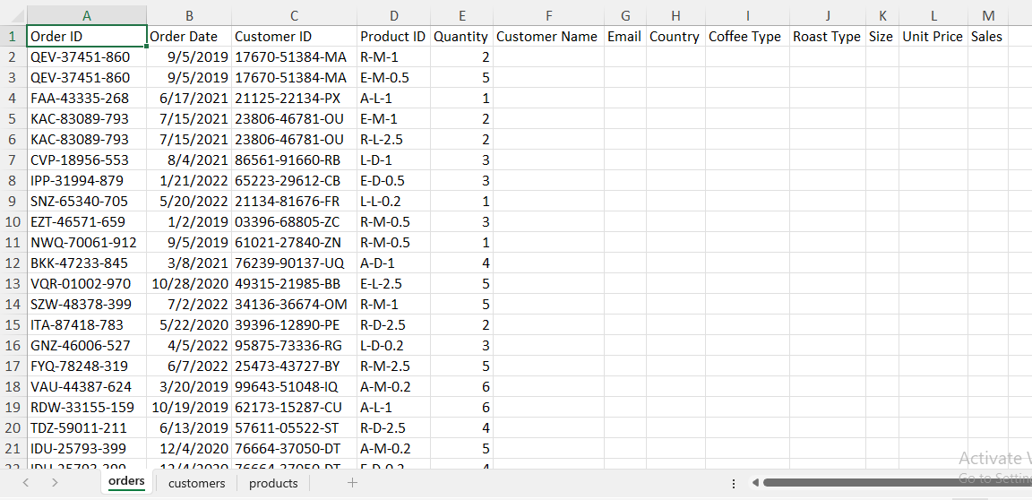
To create our data on this worksheet & fill these columns:
Omnia Mohamed. Data Analyst

Slide 16
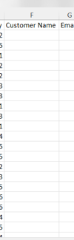
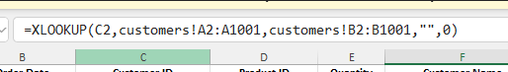
First :
Using XLOOKUP Function
To fill the customer name column.
Omnia Mohamed. Data Analyst

Slide 17
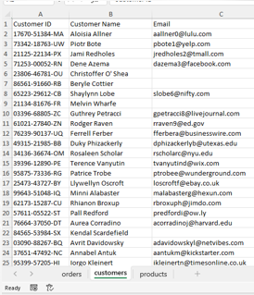
Omnia Mohamed. Data Analyst

Slide 18
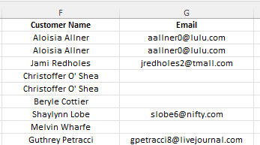
And repeat that for the column of Emails,
But the result that was founded zero 0 instead of empty cells ( blank ).
0
0
0
0
Omnia Mohamed. Data Analyst

Slide 19
To Slove it:
Using IF Function
Result:
Omnia Mohamed. Data Analyst

Slide 20
The result :
Customer Name Column had empty cells ( blank ).
1
Unique
Omnia Mohamed. Data Analyst

Slide 21
To develop this function for better result in column of customer name :
Omnia Mohamed. Data Analyst

Slide 22
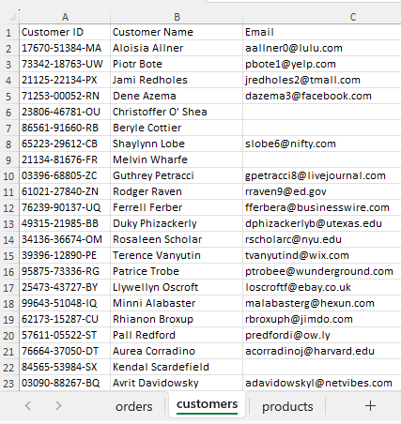
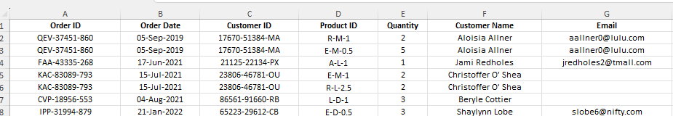
=XLOOKUP(C3,
customers!A3:A1002,
customers!B3:B1002,
XLOOKUP(G3,
customers!C1:C1001,
customers!B1:B1001,
"",0),
0)
Omnia Mohamed. Data Analyst

Slide 23
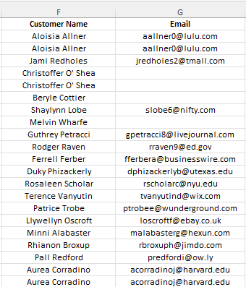
Omnia Mohamed. Data Analyst

Slide 24
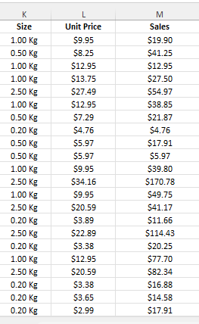
Process :
Formatting
Omnia Mohamed. Data Analyst

Slide 25
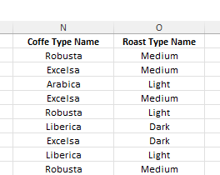
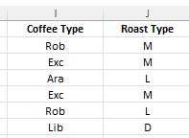
Add columns:
Result:
Omnia Mohamed. Data Analyst

Slide 26
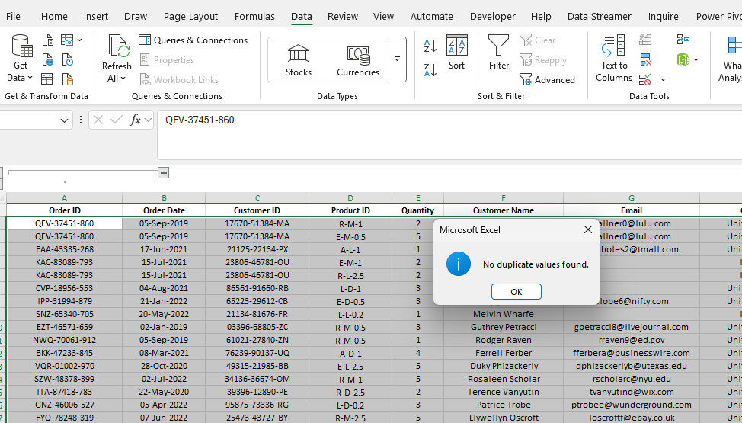
Process :
Duplicates
Omnia Mohamed. Data Analyst

Slide 27
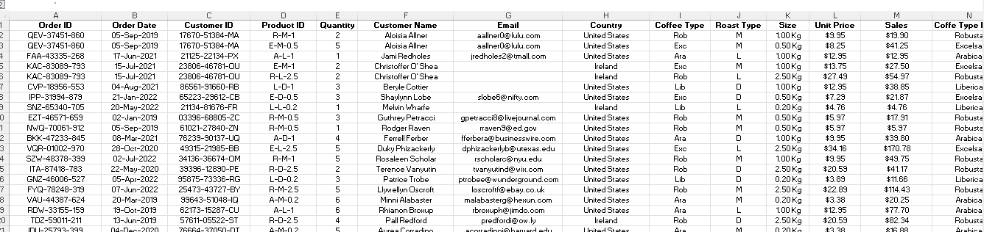
Done.
Omnia Mohamed. Data Analyst

Slide 28
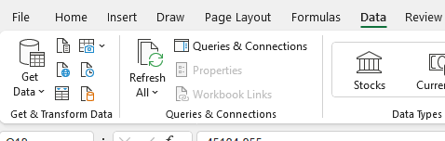
Get data
Transform
Omnia Mohamed. Data Analyst

Slide 29
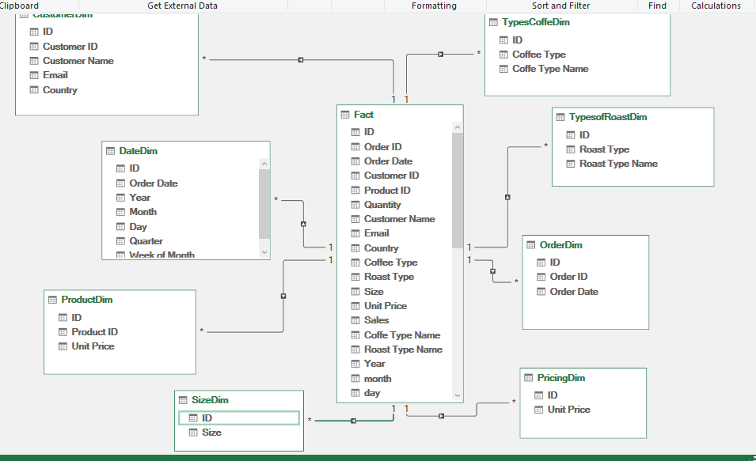
Dinormalized:
Check Duplicates
Nulls – empty cells
Add INDEX COLUMN
( the primary key )
Fact & Dim.
Remove duplicates
Load to & Modeling
Star schema
Omnia Mohamed. Data Analyst

Slide 30
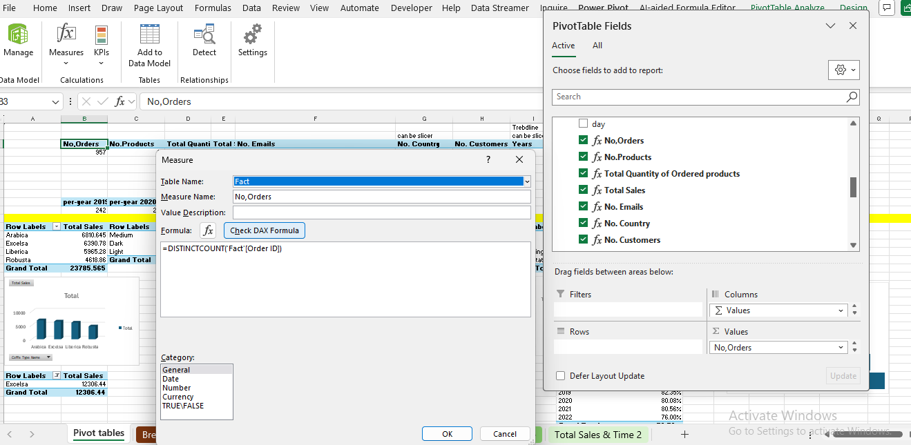
Creating
Pivot table & Measures :
Omnia Mohamed. Data Analyst

Slide 31
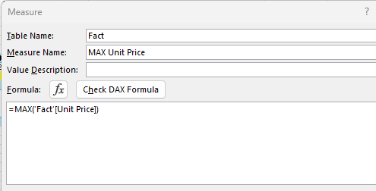
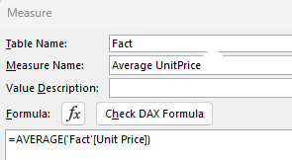
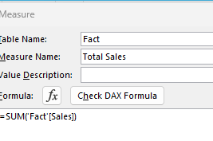
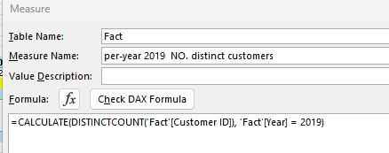
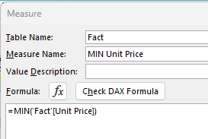
Creating
Pivot table & Measures :
Omnia Mohamed. Data Analyst

Slide 32
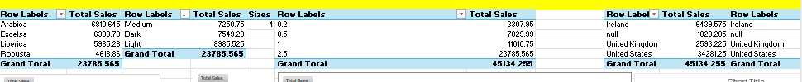
Creating
Pivot table & Measures :
Creating pivot tables for charts to build the dashboard.
Omnia Mohamed. Data Analyst

Slide 33
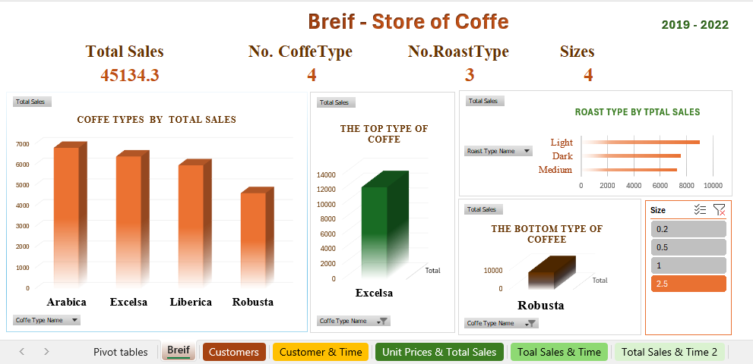
Creating Dashboard ( 6 slides )
Omnia Mohamed. Data Analyst

Slide 34
STORE OF COFFE
2019 – 2022
3. METHODS
Omnia Mohamed. Data Analyst

Slide 35
Data Analysis: Microsoft Excel
Data Visualization: Microsoft Excel
Report: Microsoft Power Point
Omnia Mohamed. Data Analyst

Slide 36
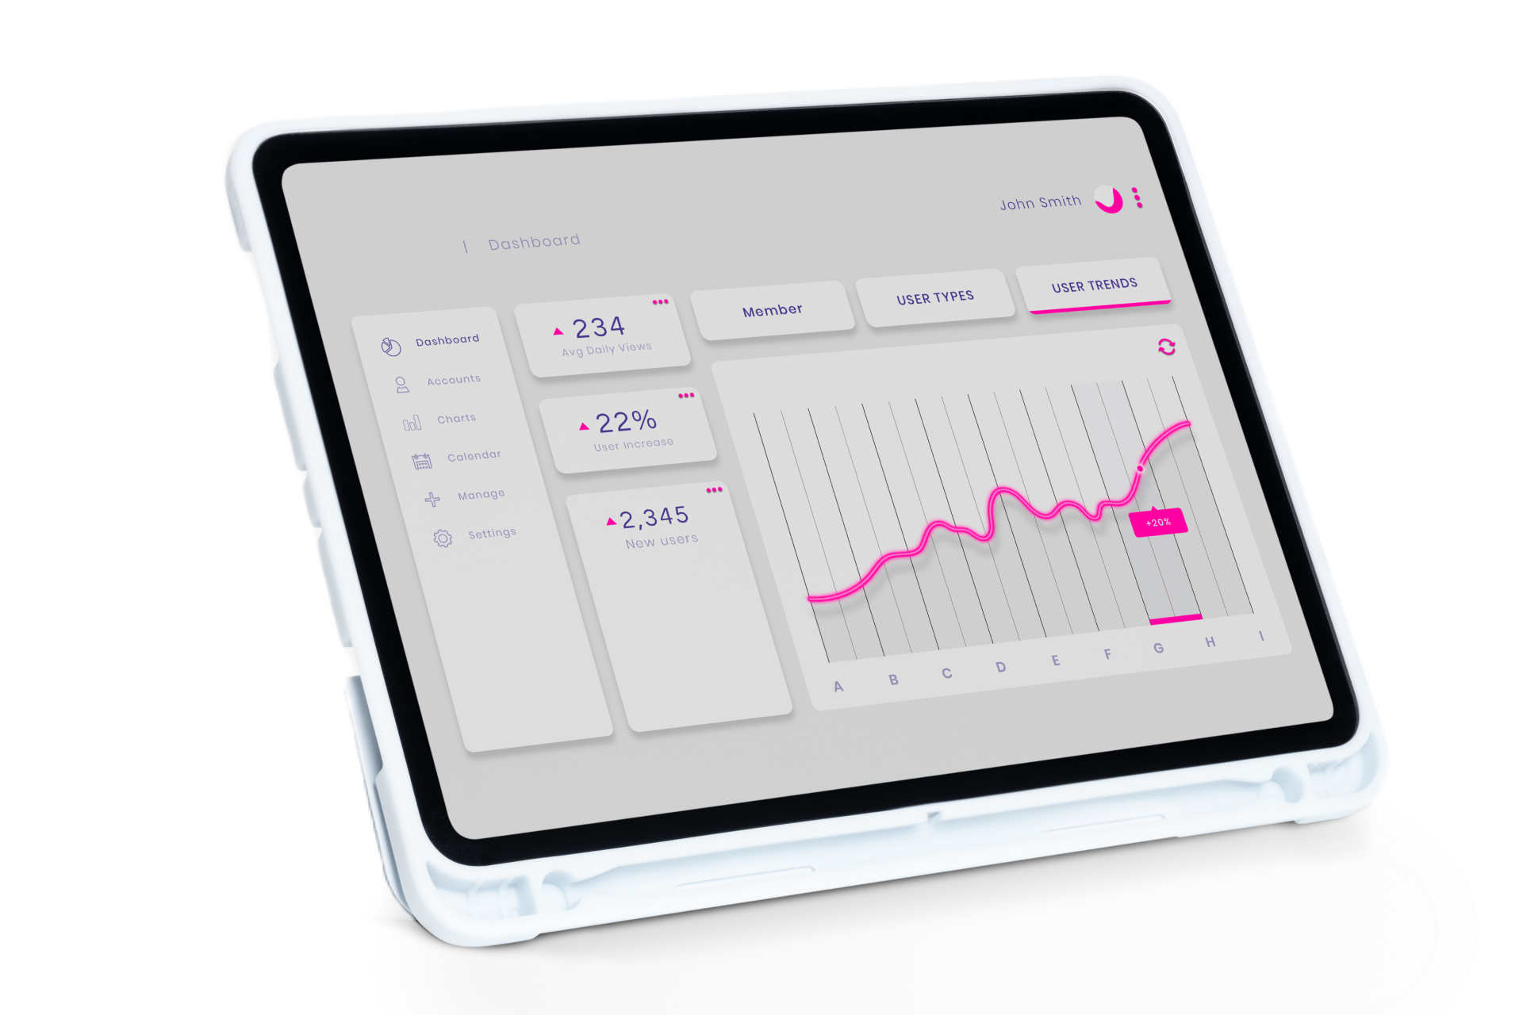
STORE OF COFFE
2019 – 2022
4. Dashboard
Omnia Mohamed. Data Analyst

Slide 37
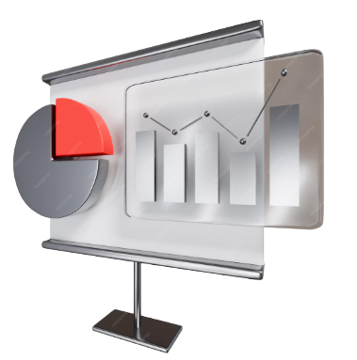
BREIF
STORE OF COFFE
2019 – 2022
Slide 1
Omnia Mohamed. Data Analyst

Slide 38
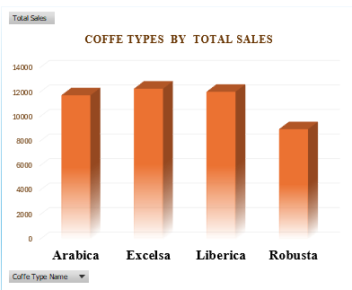

Slide 1
There’re 4 Types of
Coffee
Omnia Mohamed. Data Analyst

Slide 39
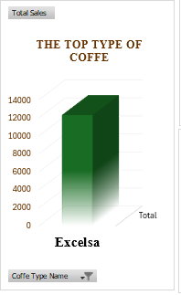


Slide 1
Top Type of Coffee :
is Excelsa.
It achieves about 27.26 %
from the Total Sales
during years.
Omnia Mohamed. Data Analyst

Slide 40
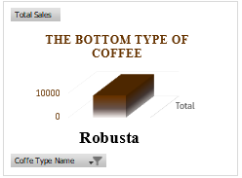
Slide 1
Least Type of Coffee :
is Robusta.
It just achieves about 19.95%%
from the Total Sales
during years.
Omnia Mohamed. Data Analyst

Slide 41
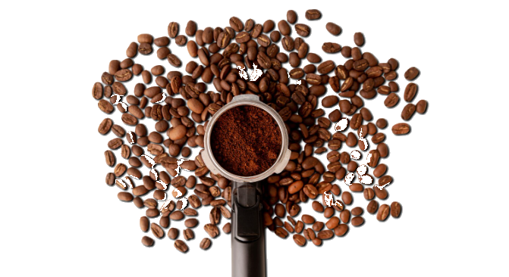
Slide 1
There’re 3 Types of
Roast
Omnia Mohamed. Data Analyst

Slide 42
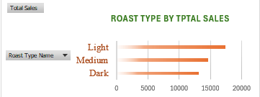
Slide 1
Top Type of Roast :
is Light
It just achieves about 38.45%
from the Total Sales
during years.
Omnia Mohamed. Data Analyst

Slide 43
Slide 1
Least Type of Roast :
is Dark
It just achieves about 38.45%
from the Total Sales
during years.
Omnia Mohamed. Data Analyst

Slide 44
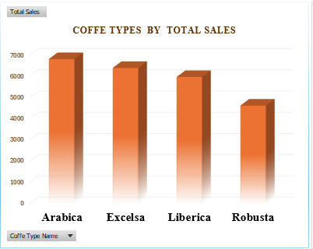
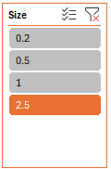
Slide 1
Largest size of type of coffee
By Total Sales :
is ARABICA.
Omnia Mohamed. Data Analyst

Slide 45
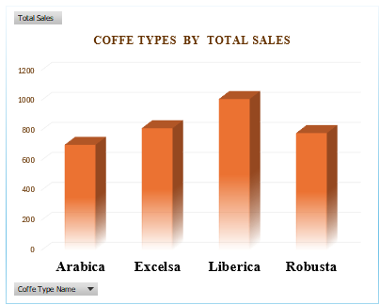
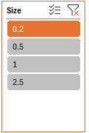
Slide 1
Smallest size of type of coffee
By Total Sales :
is LIBERCA.
Omnia Mohamed. Data Analyst

Slide 46

Slide 1
Top selling Size is the largest one ( 2.5 kg. ) achieves 52.69 % from the total sales.
Omnia Mohamed. Data Analyst

Slide 47
Customers
STORE OF COFFE
2019 – 2022
Slide 2
Omnia Mohamed. Data Analyst

Slide 48
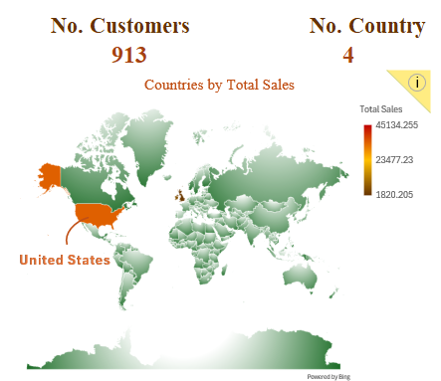
Slide 2-1
United States
the most country that our customers
are from that achieves
75.95 %
from the total sales during the years.
Omnia Mohamed. Data Analyst

Slide 49
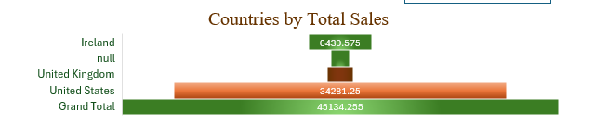
Slide 2-2
The bottom country by total sales: United Kingdom
Omnia Mohamed. Data Analyst

Slide 50
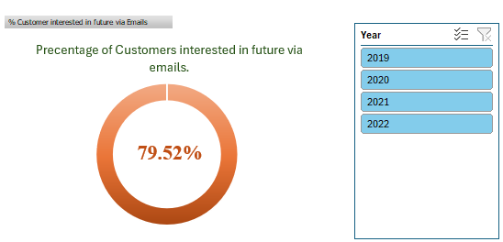
Slide 2-3
No. Customers’ Emails is so important insight that shows how many customers the interested in future via emails (new offers ,etc.)
Omnia Mohamed. Data Analyst

Slide 51
Slide 2-4
The % is above 70% ,means the most of customers were interested.
Omnia Mohamed. Data Analyst

Slide 52
Customer & Time
STORE OF COFFE
2019 – 2022
Slide 3
Omnia Mohamed. Data Analyst

Slide 53
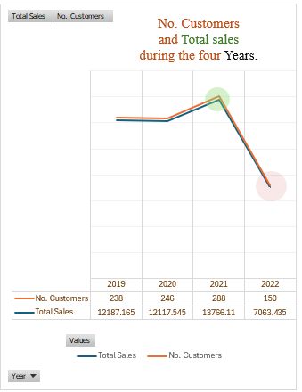
Slide 3-1
No. Customers & Total Sales:
Increases till year 2021 and after that decreased by 48.68 % in 2022.
Showed that is a problem in year 2021, BUT Actually Not.
Omnia Mohamed. Data Analyst

Slide 54
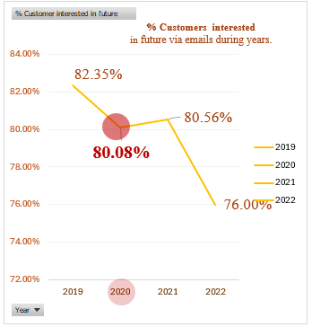
Slide 3-2
The Real Problem
was started in 2020!
That’s what this chart noticed us.
Omnia Mohamed. Data Analyst

Slide 55
Slide 3-3
THE PERCENTAGE % OF CUSTOMERS THAT INTERESTED
IN FUTURE VIA EMAILS :
was started to
DECREASE in year 2020!
Omnia Mohamed. Data Analyst

Slide 56
Slide 3-4
So that insight predicted
that the probability of no. customers will decrease in the long time.
that is showed exactly in the charts after
only 1 year, in 2022 the no. customers decreases and the sales decreases.
Omnia Mohamed. Data Analyst

Slide 57
Unit Prices & Total Sales
STORE OF COFFE
2019 – 2022
Slide 4
Omnia Mohamed. Data Analyst

Slide 58
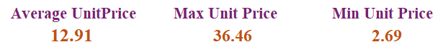
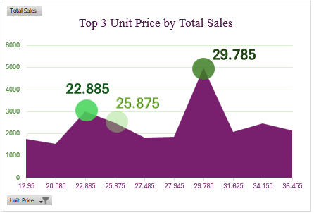
Slide 4-1
Top 3 Unit Prices that achieved most Sales are above the average of the Unit Price and near by the Max Price.
There's a probability that the most of customers do not care about the price.
Omnia Mohamed. Data Analyst

Slide 59
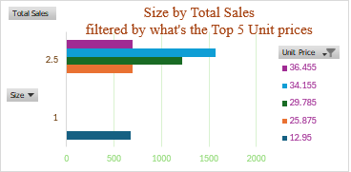
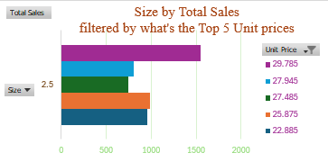
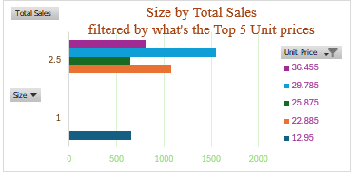
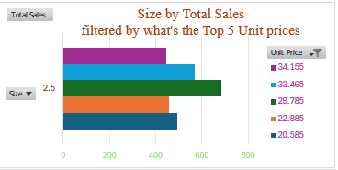
Slide 4-2
During the four years the Size 2.5 kg was the top selling size however it costs.
2019
2020
2021
2022
Omnia Mohamed. Data Analyst

Slide 60
Slide 4-3
2019
2020
2021
2022
By comparison
between Size & Unit Price:
We can conclude that it is price-insensitive.
And "The problem is not in the price.
The customers purchase the largest size no matter how much it costs."
Omnia Mohamed. Data Analyst

Slide 61
Toal Sales & Time
STORE OF COFFE
2019 – 2022
Slide 5
Omnia Mohamed. Data Analyst

Slide 62
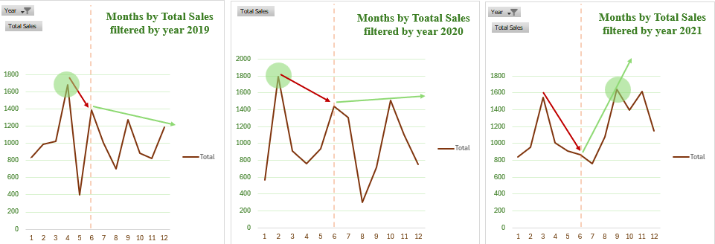
Slide 5
The most sales were achieved in the first half of the year in 2019, 2020, and 2022, & also 2021 has high sales.
We noticed that the no. months that sales decreased was in increasing year after year, and that is as shown started in 2020.
Till we see that the sales exactly decreased at the end, year after year till 2022.
Omnia Mohamed. Data Analyst

Slide 63
Total Sales & Time 2
STORE OF COFFE
2019 – 2022
Slide 6
Omnia Mohamed. Data Analyst

Slide 64
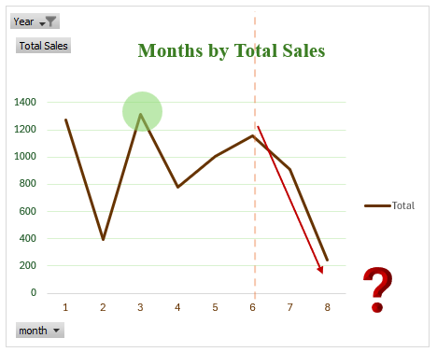
Slide 6
Important Point This Chart Shows:
We cannot say, "2022 was the worst year!
Also in the year 2022, we noticed
that the recorded data
stopped till the month of August (8).
We are not sure
that the sales decreased;
the data is missing for nearly half of the year!
Any conclusion about 2022's total performance is invalid!
Omnia Mohamed. Data Analyst

Slide 65

STORE OF COFFE
2019 – 2022
Summary
KEY FINDINGS
Omnia Mohamed. Data Analyst

Slide 66
Coffee, Roast , size
Excelsa the top coffee's type that achieves about 27.26 % from the Total Sales during years.
Robusta the least coffee's type that achieves about 19.95% from the Total Sales during years.
Light the top Roast's type However, it’s Size (kg.), it achieves about 38.45% from the Total Sales during years.
Dark the least Roast's type achieves about 38.45% from the Total Sales during years.
Largest size - 2.5 kg. - of type of coffee By Total Sales : is ARABICA.
Smallest size - 0.2 kg. - of type of coffee By Total Sales : is LIBERCA.
Top selling Size is the largest one ( 2.5 kg. ) achieves 52.69 % from the total sales.
Omnia Mohamed. Data Analyst

Slide 67
Countries, Customers
United States the most country that our customers are from that achieves 75.95 % from the total sales during the years.
On the contrary, United Kingdom is the bottom of the countries.
The Percentage of customers that are interested in future via Emails is 79.52 % means the most of customers were interested.
No. Customers & Total Sales:
Increases till year 2021 and after that decreased by 48.68 % in 2022.
Omnia Mohamed. Data Analyst

Slide 68
Problem in 2020!
The Real Problem was started in 2020!
THE PERCENTAGE % OF CUSTOMERS THAT INTERESTED IN FUTURE VIA EMAILS :
was started to DECREASE in year 2020!
that insight predicted that the probability of no. customers will decrease in the long time.
that is showed exactly in the charts after only 1 year, in 2022 the no. customers decreases and the sales decreases.
We noticed that the no. months that sales decreased was in increasing year after year, and that is as shown started in 2020.
Means that the sales focus on the one time purchase and achieving sales on a short time strategic,
Not caring from the long time sales strategics, and the customers’ loyalty.
Omnia Mohamed. Data Analyst

Slide 69
Misleading Info.
"The problem is not in the price.
The customers purchase the largest size no matter how much it costs."
The most sales were achieved in the first half of the year in 2019, 2020, and 2022, & also 2021 has high sales.
We cannot say, "2022 was the worst year!
Also in the year 2022, we noticed that the recorded data stopped till the month of August (8).
We are not sure that the sales decreased; the data is missing for nearly half of the year!
Any conclusion about 2022's total performance is invalid!
Omnia Mohamed. Data Analyst

Slide 70

STORE OF COFFE
2019 – 2022
Conclusion
RECOMMENDATIONS
Omnia Mohamed. Data Analyst

Slide 71
Sales Department
The sales focus on the one-time purchase and achieving sales on a short time strategic,
Not caring from the long-time sales strategics, and the customers’ loyalty.
The most sales were achieved in the first half of the year in 2019, 2020, and 2022, & also 2021 has high sales.
Recommendations:
Develop Strategics for a long time
Focus on customers’ loyalty.
More offers in the first half of year.
% Emails & service
The % of customers that wrote their emails decreased and may be caused of the service in branches.
Recommendations:
Focus on the quality service in branches.
Omnia Mohamed. Data Analyst

Slide 72
Countries & Marketing
Most of customers are from United States.
Recommendations:
Growth the knowledge of the habits and emotions about people is in this area, and make it benefits in marketing, to increase the attracting this kind of audience.
Size & Products
Largest size is the most achievable selling product.
Recommendations:
You can remove the lowest sizes and provide extra large sizes.
And after that increases the price with concentrating not to be overpricing, so you may be lose many of customers.
Omnia Mohamed. Data Analyst

Slide 73

Thank You!
Omnia Mohamed. Data Analyst

